Slide 1

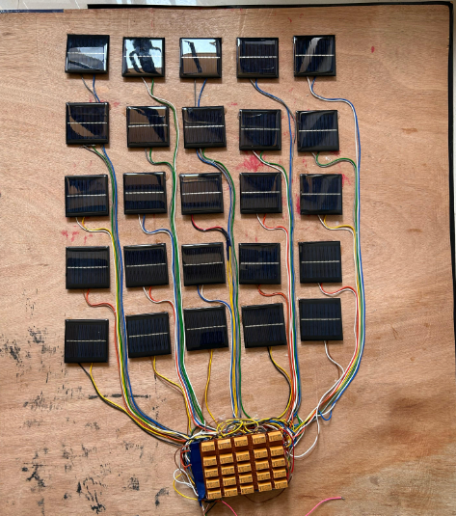
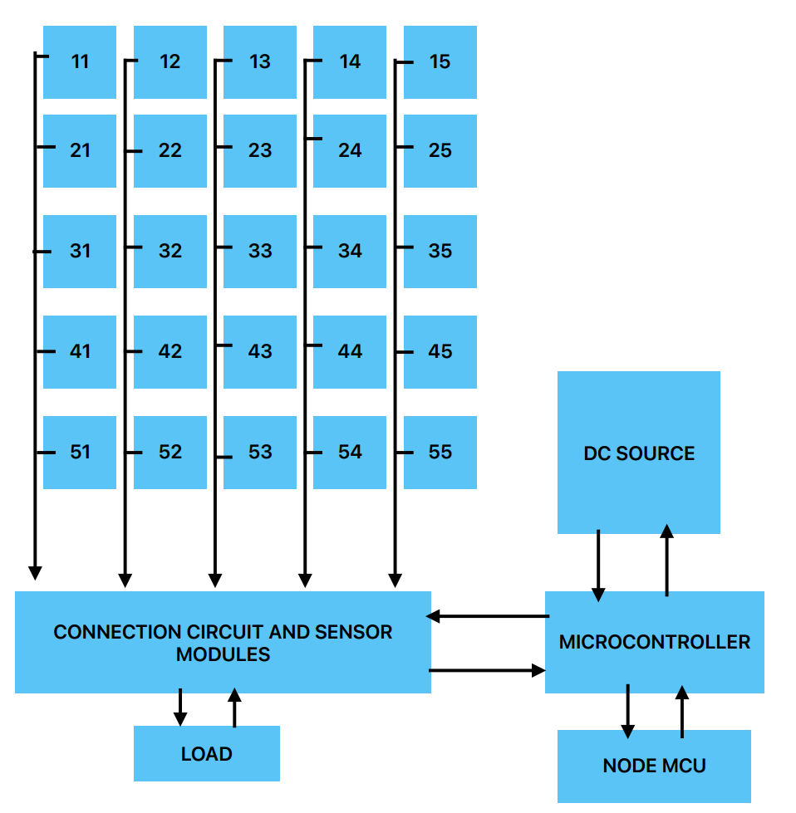
TITLE
Academic Year
2025-2026
NAME OF STUDENTS
Project Guide: NAME OF FACULTY
Introduction
Block Diagram/Figure
…….
……
Objectives
…..
……
Results
Figure. Developed hardware.
…..
Achievements
Methodology
…..
…….
….
…..
Conclusions
…..
…………..
DEPARTMENT OF ELECTRICAL & ELECTRONICS ENGINEERING
(NBA Accredited)

